Slide 1
Telecom Churn Prediction
Team Members:
ANJANA KAMANA
NIKHITHA BEECHARAJU
MELISSA MARY SMITH
MUGDHAMA KISHOR PATIL

Slide 2
Introduction
Customers’ churn is a considerable concern in telecommunication sectors with high competitive services. Predicting the customers who are likely to exit is customer churn prediction.
The company will represent potentially large additional revenue source if it’s prediction is done in the early phase.
Many research's confirmed that machine learning technology is highly efficient to predict this situation. This technique is applied through learning from given data of the customers.

Slide 3
Introduction
We focused on evaluating and analyzing the performance of a set of tree-based machine learning methods and algorithms for predicting churn in telecommunications companies.
We have experimented a number of classification algorithms such as Decision Tree, Random Forest tree , Support Vector Machine ,Naive Bayes, K Nearest Neighbor Classifier to build the predictive model of customer Churn after developing our data preparation, feature engineering, and feature selection methods.

Slide 4
Problem Statement
Customer churn is a major problem and one of the most important concerns for large companies.
Given a dataset with attributes, the aim is to build a predictive model that determines if the customer is going to exit or will continue with the company.
Exiting or continuing of a customer are binned as 0’s and 1’s(no or yes)
in the given dataset.
The prediction task is to determine whether the customer Is exiting or not.

Slide 5
Objectives
To test the dataset using different machine learning algorithms and find the best one.
To fit the dataset into the best model.
For prediction of data the model with highest accuracy is considered or chosen.
Finally to make the User Interface for easy use of the application

Slide 6
Technologies Used
Operating System: Machine Learning is platform independent, it can be accessed on Android, Windows, Linux or any other OS the user wishes to open.
Programming Languages: Python,HTML
Tools: The tools used to create the project are:
Jupyter Notebook
Spyder

Slide 7
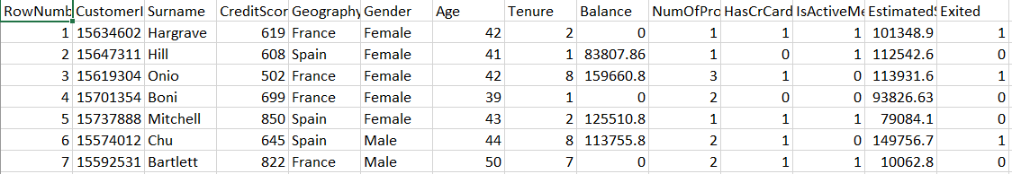
Dataset
We use a dataset containing different attributes used to predict the
exiting of the customer.

Slide 8
Algorithm
Different datasets need different algorithms.
We need to identify the best algorithm among them which has more accuracy and efficiency
Here we have used ‘Random Forest Algorithm’ for our dataset as it gives the highest accuracy.
We use the classification algorithm, as we have the dataset of more than one independent variables and a dependent variable that has categorized values.

Slide 9
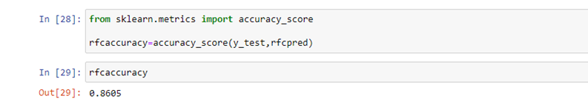
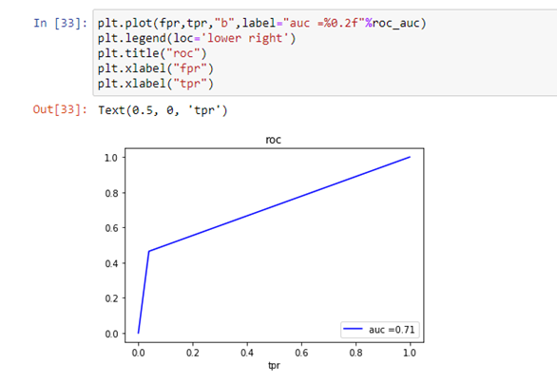
Random Tree Classifier
When we applied the random tree classifier to the data set , the accuracy obtained was 86.05% and AUC value was 0.71

Slide 10
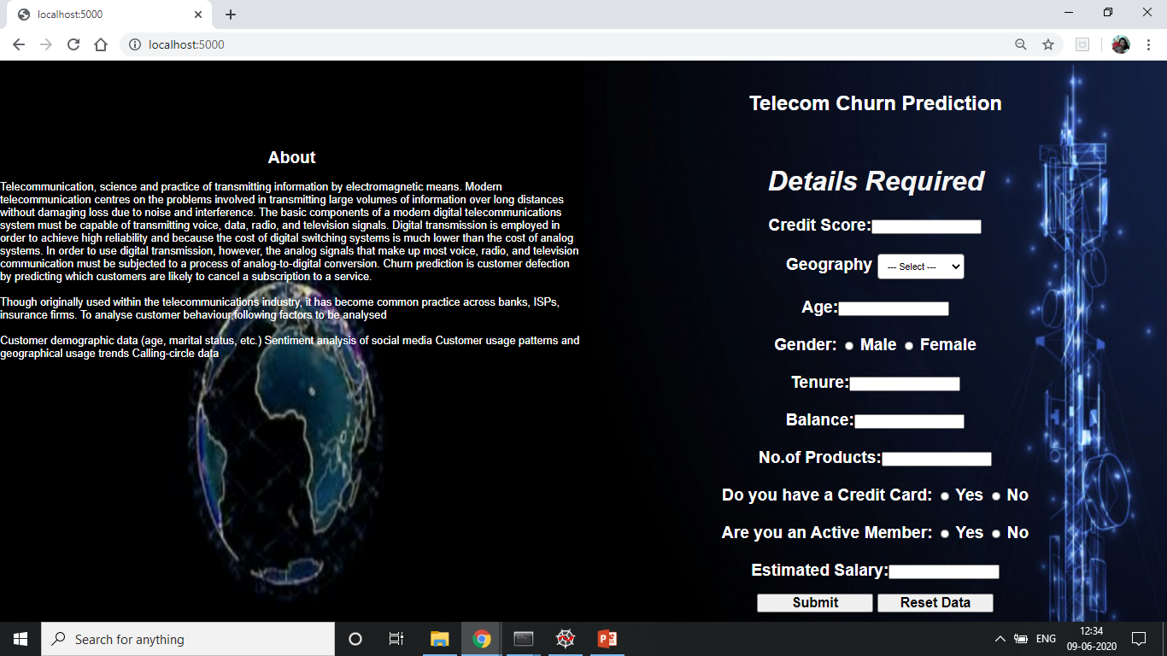
WEB APPLICATION(UI)

Slide 11
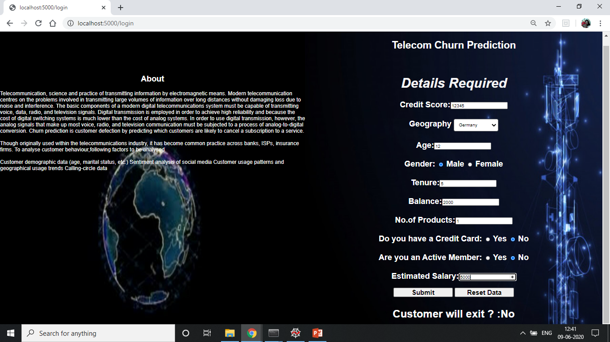
PREDICTION RESULT

Slide 12

PREDICTION RESULT

Slide 13
Conclusion
The Random Forest algorithm used is efficient to predict the income.
We got the accuracy of 86.0% there is no such algorithm derived that can predict 100% accuracy.
Machine Learning overall is a very powerful tool to revolutionize the way things work.
It is very user-friendly and hence helps the user to predict the data easily and simultaneously and keeps improving the accuracy and efficiency by itself.

